Slide 1
SWENG3101
Object Oriented Programming
Software Engineering Department
AASTU

Slide 2
Chapter 1
Introduction to Object Oriented Programming

Slide 3
Objectives
At the end of this chapter you should be able to:
  Discuss and contrast the issues, features, design and concepts of programming paradigms
  Choose and apply a suitable programming paradigm and language to solve a given problem.
  Understand basic terms of OOP

Slide 4
Outline
Program Development
Programming Paradigms
Overview of OO principles

Slide 5
Problem Solving
The purpose of writing a program is to solve a problem
Solving a problem consists of multiple activities:
  Understand the problem
  Design a solution
  Consider alternatives and refine the solution
  Implement the solution
  Test the solution
These activities are not purely linear – they overlap and interact

Slide 6
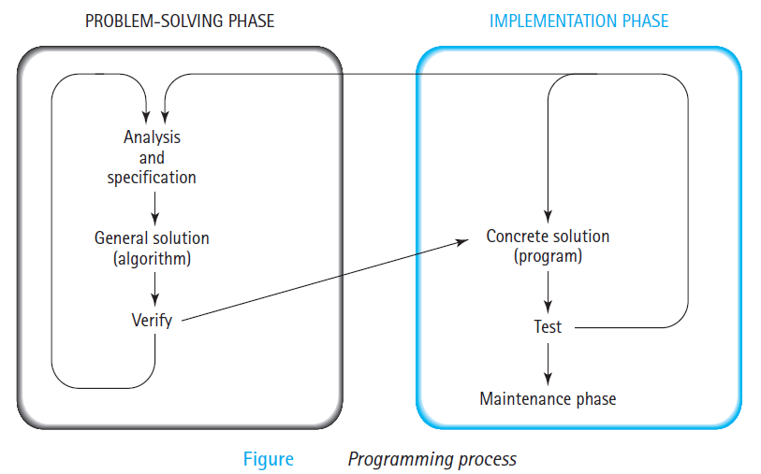
Cont’d
To write a program for a computer to follow, we must go through a two-phase process: problem solving and implementation.

Slide 7
Program Development
The mechanics of developing a program include several activities
  writing the program in a specific programming language (such as java)
  translating the program into a form that the computer can execute
  investigating and fixing various types of errors that can occur
Software tools can be used to help with all parts of this process

Slide 8
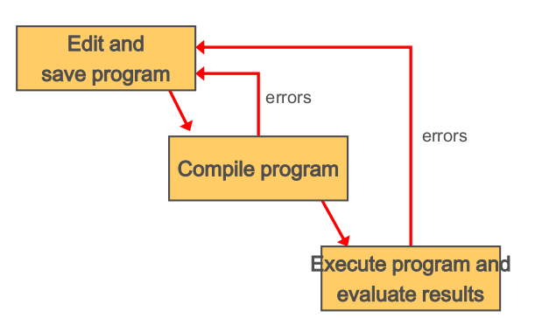
Program Development(cont’d)

Slide 9
Programming Languages
A programming language specifies the words and symbols that we can use to write a program
A programming language employs a set of rules that dictate how the words and symbols can be put together to form valid program statements
A program must be translated into machine language before it can be executed
A compiler is a software tool which translates source code into a specific target language
  Often, that target language is the machine language for a particular CPU type. The Java approach is somewhat different

Slide 10
Programming Paradigms
Programming paradigms are the result of people’s ideas about how programs should be constructed
A programming paradigm can be understood as an abstraction of a computer system
Different problems are better suited to different paradigms
In reality, very few languages are “pure”
  Most combine features of different paradigms
Main programming paradigms
  Imperative paradigm
  Functional paradigm
  Object-oriented paradigm
  Logical paradigm
Notes:
Imperative: a series of steps and state changes describing how the computation is achieved
Declarative paradigm: specifying the result you want, not how to get it
Abstraction e.g.
OOP: collection of interacting objects
Functional: sequence of stateless function evaluations

Slide 11
Imperative paradigm
Programming with an explicit sequence of commands that update state
Specifying the steps the program must take to reach the desired state.
  First do this and next do that
E.g. Fortran(FORmula TRANslator), Cobol(COmmon Business Oriented Language), Pascal, Ada, C
Notes:
OO programming is not always imperative, but most OO languages have been imperative

Slide 12

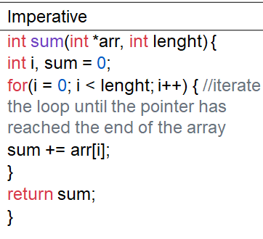
Functional Paradigm
It emphasizes the application of functions
Suitable for mathematical computations
E.g. LISP, Haskell
E.g. Calculate the sum of an array of a list of numbers

Slide 13
Declarative Programming
Represents the logic of a computation
Defining the algorithm in terms of all possible cases without explicitly stating how each case is accessed
Programs describe what the computation should accomplish, rather than how it should accomplish it.
E.g. Prolog, SQL
Useful for
  Logic-based problems
Disadvantage
  Difficult to see what is actually happening computationally

Slide 14
The Object-Oriented Paradigm
Represent the problem as a set of interacting objects
E.g., Smalltalk, Java, C++, etc.
A class specifies the format of objects
Send messages between objects to simulate the temporal evolution of a set of real world
Useful for:
  Large complex systems
  Highly flexible, extensible systems
Disadvantages
  Slower
  Large memory requirements

Slide 15
Overview of OOP
Everywhere you look in the real world you see objects — people, animals, plants, cars, planes, buildings, and computers and so on.
Humans think in terms of objects. Telephones, houses, traffic lights, microwave ovens and water coolers are just a few more objects.
Humans learn about existing objects by studying their attributes and observing their behaviors.
Programs are composed of lots of interacting software objects
  Have properties (attributes): describe the state/data of an object at a certain time
    e.g., size, shape, color and weight
  Exhibit behaviors(Method)
    e.g., a ball rolls, bounces, inflates and deflates; a baby cries, sleeps, crawls, walks and blinks; a car accelerates, brakes and turns

Slide 16
Overview of OOP(cont’d)
Different objects can have similar attributes and can exhibit similar behaviors.
A program written in object-oriented style will consist of interacting objects.
  E.g. 1 For a program to keep track of student residents of a college dormitory, we may have many Student, Room, and Floor objects.
  E.g. 2 For program to keep track of customers and inventory for a bicycle shop, we may have Customer, Bicycle, and many other types of objects.

Slide 17
OOP Principles
In object oriented programming, the main part in a program are classes, rather than procedures.
The object-oriented approach lets (allows) you create classes and objects that model real world objects.
Object:
  Basic units of object oriented programming
  An object can be considered a "thing" that can perform a set of related activities.
  The set of activities that the object performs defines the object's behavior. For example, the Hand (object) can grip something, or a Student (object) can give their name or address.
  An instance of a class

Slide 18

OOP Principles(cont’d)
Class:
  A class is simply a representation of a type of object.
  A collection of objects of similar types.
  Set of objects that share common structure and behavior.
  It is the blueprint, or plan, or template, that describes the details of an object.
  Class is composed of three things: a name, attributes, and operations.
  class is like a cookie cutter
Notes:
Method: Encapsulated the behavior of the object and provide interface to the object
Attributes: Describe the state/data of an object at a certain time

Slide 19
OOP Principles(cont’d)
Example
Class: Phone
  attributes: Type, Name, Model type, Size, Screen color,…
  Method: make-call (), Receive-call (), Send-message (), Receive-message (), Take-picture (), …

Slide 20
OOP Principles(cont’d)
Four concepts are critical to understanding object models:
  Data abstraction
  Polymorphism
  Inheritance
  Encapsulation
These can be remembered with the acronym “A Pie,” for Abstraction, Polymorphism, Inheritance, Encapsulation.

Slide 21
Data- abstraction
principle of ignoring those aspects of an object that are irrelevant to concentrate on those that is relevant.
... relevant to the given project
Focusing on the essential features and ignoring the non-essential ones.
Abstraction separates objects from the extra data and behavior that doesn’t directly belong there.
Example: In university, if a student asked address might say Woreda 02, House No:xxxx, AA; (wouldn’t tell the number of rooms, color of walls, seats,…)
“Relevant” to what?

Slide 22
Encapsulation
Encapsulation is the mechanism that binds together code and the data it manipulates, and keeps both safe from outside interference and misuse.
Wraps attributes and operations (behaviors) into objects — an object’s attributes and operations are intimately tied together.
It is the insulation of data from direct access.
Objects have the property of information hiding.
Objects may know how to communicate with one another across well-defined interfaces, but normally they are not allowed to know how other objects are implemented.
  implementation details are hidden within the objects themselves.

Slide 23
Encapsulation (cont’d)
E.g 1. We can drive a car effectively without knowing the details of how engines, transmissions, brakes and exhaust systems work internally—as long as we know how to use the accelerator pedal, the brake pedal, the wheel and so on.
E.g. 2. Encapsulation allows us to consider what a light switch does, and how we operate it, without needing to worry about the technical detail of how it actually works.

Slide 24

Inheritance
The process by which objects of one class acquire the properties of objects of another class.
An object oriented system organizes classes in to a sub- class, super -class hierarchy. At the top of the hierarchy are the most general classes and at the bottom are the most specific one.
Sub class inherits all of the properties (non-private attributers) and methods defined in its super class.
Inheritance provides the idea of reusability (allowing objects to be built from other objects).
Inheritance represents the is a relationship between data types. For example: A sailboat is a boat.

Slide 25
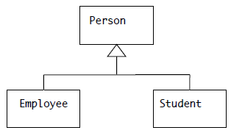
Inheritance(cont’d)
Example: Consider people at AASTU. Broadly speaking, they fall into two categories: employees and students.
  1. There are some features that both employees and students have in common - whether a person is an employee or a student, he or she has a name, address, date of birth, etc.
  2. There are also some features that are unique to each kind of person - e.g. an employee has a pay rate, but a student does not; a student has GPA, but an employee does not, etc.
“is –a” relationship

Slide 26
Polymorphism
Polymorphism (from the Greek, meaning “many forms”)
It is a feature that allows one interface to be used for a general class of actions.
Polymorphism mainly requires the ability for different objects to have methods with the same name, but different parameters.
Any of the objects referenced by this name is able to respond to some state of operations in a different way.
Using functions in different ways depending on what they are operating on (function overloading) is polymorphism,
one thing with several distinct forms.
E.g. Your mobile phone, one name but many forms as phone, as camera, as mp3 player, as radio

Slide 27
Polymorphism (cont’d)
Analogy, a dog’s sense of smell is polymorphic.
  If the dog smells a cat, it will bark and run after it.
  If the dog smells its food, it will salivate and run to its bowl.
  The same sense of smell is at work in both situations. The difference is what is being smelled, that is, the type of data being operated upon by the dog’s nose!
What is the advantage?

Slide 28
Dynamic binding
The process of determining dynamically which function is to be involved (i.e. at runtime).
Making this determination at compile time is called static binding.
Overloaded methods are resolved at compile time based on the arguments supplied.
Overridden methods are resolved at run time.
If a subclass methods has the same name, parameter list and return types as super class method, it is said that the sub-class method overrides the super class method

Slide 29
Activity
Identify objects, attributes and methods
  Student Information Management System
  Hotel Reservation System
  Online Shopping System

Slide 30
Postman tool

